Slide 1
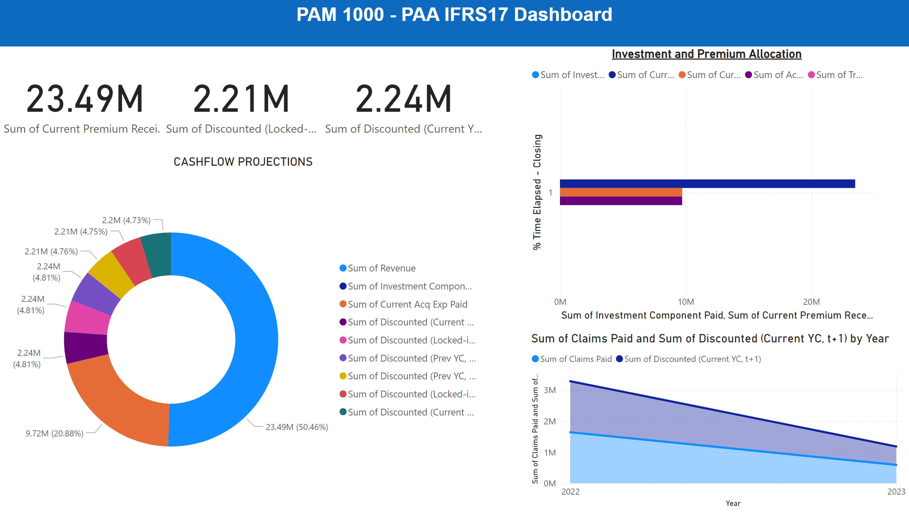
Page 1
Notes:
textbox
No alt text provided
card
No alt text provided
card
No alt text provided
CASHFLOW PROJECTIONS
No alt text provided
card
No alt text provided
Investment and Premium Allocation
No alt text provided
stackedAreaChart
No alt text provided

